Slide 1

Be-Fit
Team Members
Neelesh Saladi
Ravichander Reddy Goli
Rohitha Reddy Meda
Sai Rohith Gorla

Slide 2
Introduction to the Problem
In the current time of pandemic it is very difficult for people to go to gym and also take precautions of COVID19 Pandemic. To overcome this problem we are proposing this application Be Fit.
By using this application people can book their slots as per their requirement.
Neelesh Saladi

Slide 3
Proposed Solution
Be Fit is a Android application which helps us in pre-booking the dates for different exercise routines that are offered in the gym, In the current times of covid19 kind of situations people are more worried about their health and safety, So if they have option to pre book the slot in gym in which there will be limited number of people and also Users can also get to choose various kind of “Exercise Routines” schedule them with appropriate times it helps in assuring the safety of the users.
Neelesh Saladi

Slide 4
Features
User can book the slots and the user will be displayed with the amount will be charged per session. He can view the total amount in rate card activity and can pay by the end of the month at store.
Neelesh Saladi

Slide 5
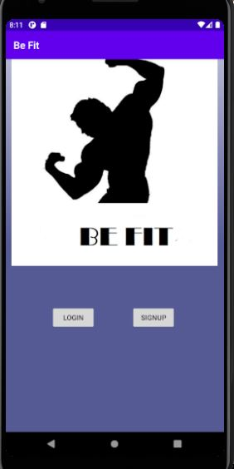
Main Activity
The application Be-Fit starts with the Main Activity, In this we can see the Login Option for already existing Users and a Signup Option.
Rohitha Reddy

Slide 6
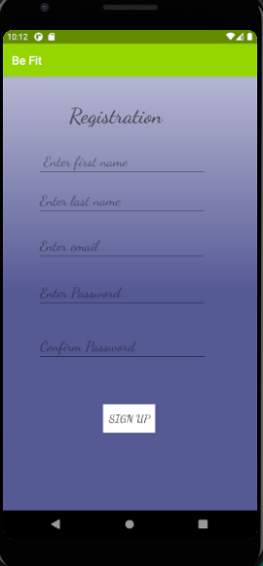
Signup Activity
In this activity user need to signup by giving all required fields.
In Sign Up, User has to provide his/her basic information such as Username, E-Mail, Phone number, Password. By signing user can have easy and unlimited access to the application.
Rohitha Reddy

Slide 7
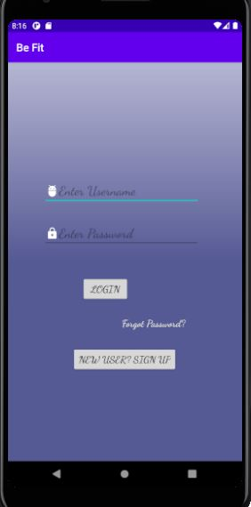
Login Activity
In login activity, user can login by entering his/her credentials to their registered account.
Rohitha Reddy

Slide 8
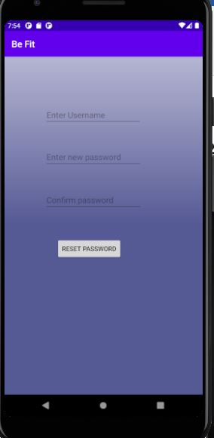
Forget Password Activity:
This activity helps User in changing their password.
Rohitha Reddy

Slide 9
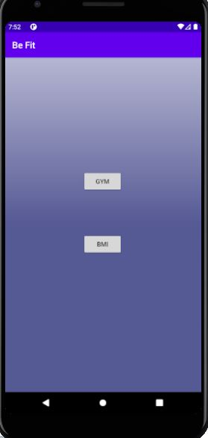
Home Activity:
In the Dashboard activity we have added a BMI calculator and the Exercise Routine menu starts from the Gym.
Sai Rohith Gorla

Slide 10
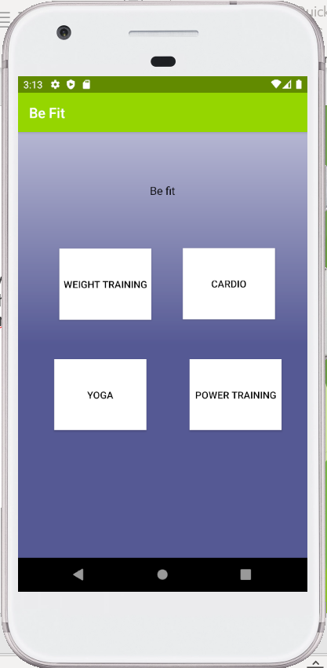
Gym Activity:
User will be redirected into the dashboard activity. In this activity user can find different categories of workouts such as weight training, Cardio, Yoga, Power Training. By clicking on any of these categorie’s user will be redirected to respective page.
Sai Rohith Gorla

Slide 11
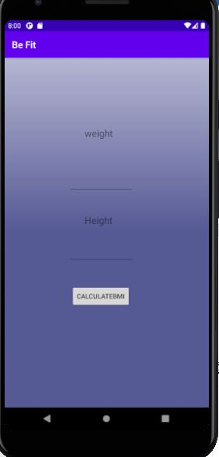
BMI Calculator Activity:
This Activity is present in the Dashboard activity from there we can access it and User can calculate their Body, Mass, Index in this Activity. It helps us to find the Fat level in the Body and BMI can be used to test for weight groups that can lead to health issues but do not assess body fat or individual fitness.
Sai Rohith Gorla

Slide 12
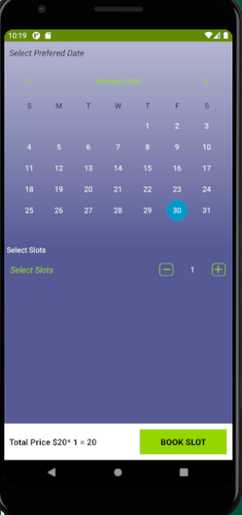
Training Activities
From the Gym activity users will select a particular training from which they will be re-directed to the calendar page where they get to choose the date and number of slots.
Ravichander Reddy
Neelesh Saladi

Slide 13
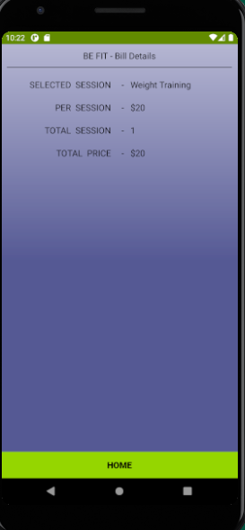
Rate Card Activity:
In this activity all the selected slots of the user will be displayed at the same place by calculating the total amount per each workout session. For every workout there will be different prices so the final amount will be calculated in the page for the User to check pricing details.
Neelesh Saladi

Slide 14
Problems Faced:
In our Application Be Fit we are using Firebase Database which allows us to syncing the Real-time data into the Database, The difficult part is that while handling the data we can easily upload it into the Database but while retrieving the data back to the Application and storing in the Spinners.
And we faced a lot of problems with the git merge conflicts, we have to be very careful with it while committing the data and pulling it back by the other contributor’s we nearly lost the whole project once because of not being aware of the conflict.
Neelesh Saladi

Slide 15
Future Improvements
We can develop this application in many particular ways, we can add some activities of diet and exercise management where we can upload the data and videos on different diets and also some exercise videos for the users which helps them to access that data with some payment option.
We can add some more exercise activities with some research and a time slot management for a better tracking user performance purposes.
Neelesh Saladi

Slide 16
Thank You

